Slide 1


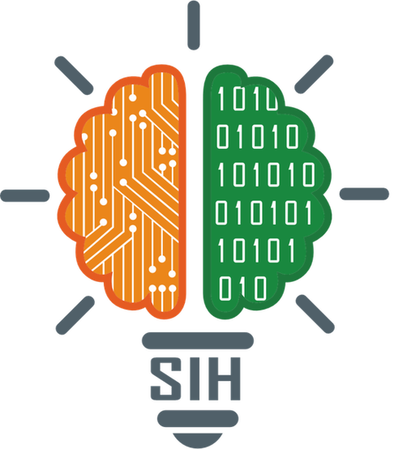
SMART INDIA HACKATHON 2025
    Problem Statement ID –26196
    Problem Statement Title-Student Innovation
    Theme-MedTech/BioTech/HealthTech
    PS Category-Software
    Team ID-98
    Team Name-Git_commit_win

Slide 2



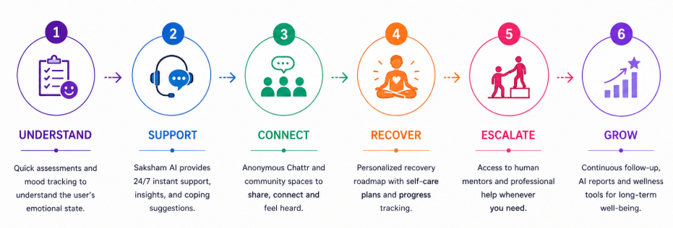
Git_Commit_Win
Proposed Solution
Problem Understanding
🔴 Fragmented Support
Disconnected services make mental-health care inaccessible, private, and non-continuous.
🔴 Lack of Personalization
Limited personalized recovery, peer connection, and human support leaves students without holistic care.
USP – What Makes HealHub Unique
  Safety-First Architecture: Built with safety at its core, not as an afterthought.
  Pre-emptive Crisis Detection: Every AI interaction is intercepted by a safety layer before reaching the main model.
  Comprehensive Ecosystem: Blends anonymous-yet-accountable peer support, mood-personalized interventions, and a performance-paid mentor economy.
  Production-Ready: A fully functional, live end-to-end product—not just a prototype.
.
  24/7 Saksham AI: Crisis-aware wellness bot (CBT/DBT) with instant auto-escalation to the iCall helpline.
  Mood Journaling: Quick check-ins and diary entries, visualized on a 30-day trend graph.
  AI Wellness Reports: Automated weekly/monthly scores tracking stress, hope, and sentiment.
  Clinical Assessments: 12 built-in clinical tests like PHQ-9 and GAD-7.
  Personalized Exercises: Live breathing and grounding resets tailored to your current mood.
  Recovery Roadmaps: 21/60-day structured plans with streaks and badges for addiction recovery.
  Chattr (Anonymous Chat): Fast, secure, WebSocket-based anonymous matchmaking with zero message history.
  Live Community Spaces: Real-time, user-created feeds with instant voting and comments.
  SoulScape & Mind Games: Calming virtual environments and healthy brain-training games
  Verified Mentors: Secure video sessions with LinkedIn-verified human guides
@SIH Idea submission- Git_Commit_Win
2

Slide 3

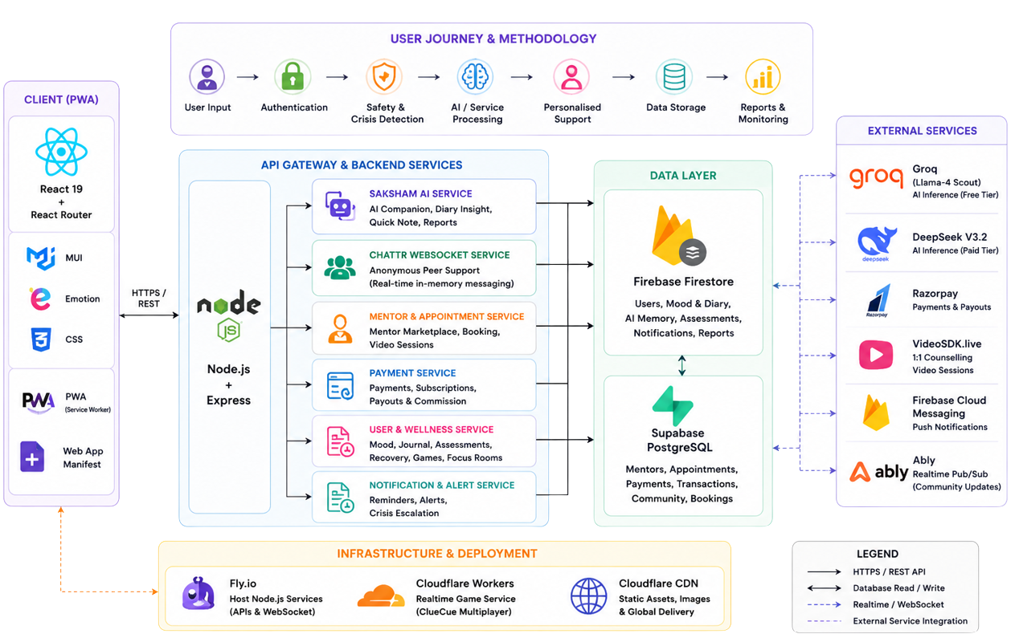
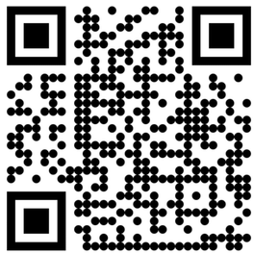

Git_Commit_Win
TECHNICAL APPROACH
@SIH Idea submission- Git_Commit_Win
3

Slide 4

Git_Commit_Win
FEASIBILITY AND VIABILITY
FEASIBIITY OF THE IDEA:-
💻 Technical: Core buildable with GPT-4, Firebase, React Native; advanced (mentor booking)- needs funding.
⚙️ Operational: Mentor/therapist partnerships viable.
📈 Market: Post-COVID boom; demand for all-in-one, stigma-free mental health solutions.
✨ Differentiators: Sentiment tracking, addiction test, mentor access.
💵 Economic: Lean MVP via open-source; revenue from subscriptions, premium counseling, partnerships..
🚨 Major Risks & Solutions:-
Data Privacy → Risk of leaks → ✅ Encrypt, anonymize, ensure HIPAA/GDPR compliance.
AI Accuracy → Misread harmful emotions → ✅ Hybrid AI + human review, crisis support links.
User Retention → Drop-off after excitement → ✅ Gamification, personalized insights, mentor/community support.
⭐ Supporting Facts for Feasibility and Viability ⭐
A May 2022 IMARC survey found 61% of women and 55% of men in India use digital tools for mental well-being. The Indian mental health app market is projected to grow from $498M (2024) to $1.41B by 2030, CAGR 18.5%.
@SIH Idea submission- Git_Commit_Win
4
4

Slide 5
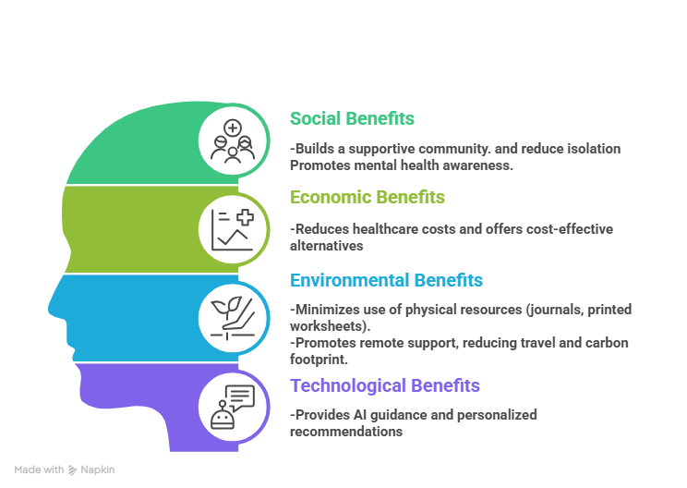
Git_Commit_Win
IMPACT AND BENEFITS
Potential Impact
Enhanced Mental Health Awareness: Users gain insights into their emotions, mood patterns, and mental well-being through diary entries, mood tracking, and sentiment monitoring.
Early Detection of Harmful Emotions: Harmful sentiments are identified early, helping prevent escalation of mental health issues.
  Access to Support and Guidance: Mentorship, counseling sessions, and a 24/7 AI chatbot provide emotional support and guidance anytime.
  Encouragement of Positive Habits: Streak tracking, gamified self-care activities, and resource hubs motivate consistent engagement and personal growth.
  Self-Empowerment: Users make informed decisions about their mental health and develop emotional resilience.
@SIH Idea submission- Git_Commit_Win
5
5

Slide 6
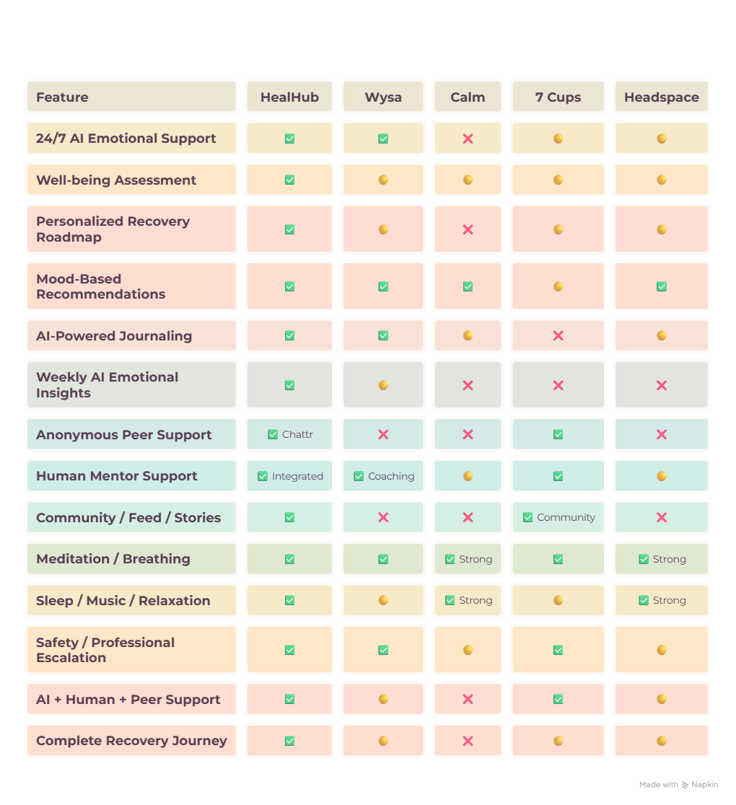




RESEARCH AND REFERENCES
Git_Commit_Win
Research Gap
    Fragmentation: Existing platforms deliver isolated interventions; HealHub integrates the full ecosystem.
    Safety & Oversight: Addresses current AI limitations regarding safety, hallucinations, and crisis escalation protocols.
    Engagement: Moves from reactive/repetitive tools to predictive/adaptive behavioural intelligence.
    Longitudinal Intelligence: Continuous emotional profiling vs. independent, isolated interactions.
    Key References
    Primary Academic :
      “Artificial Intelligence-Enabled Chatbots in Mental Health: A Systematic Review”
      Authors: Batyrkhan Omarov, Sergazi Narynov, Zhandos Zhumanov (August 2025)
      DOI: 10.32604/cmc.2023.034655
    Market Data:
      IMARC Survey (May 2022): 61% of women/55% of men in India utilize digital mental health tools.
      Projected growth: Indian mental health app market from $498M (2024) to $1.41B (2030), CAGR 18.5%.
@SIH Idea submission- Git_Commit_Win
6

